Slide 2


Slide 3
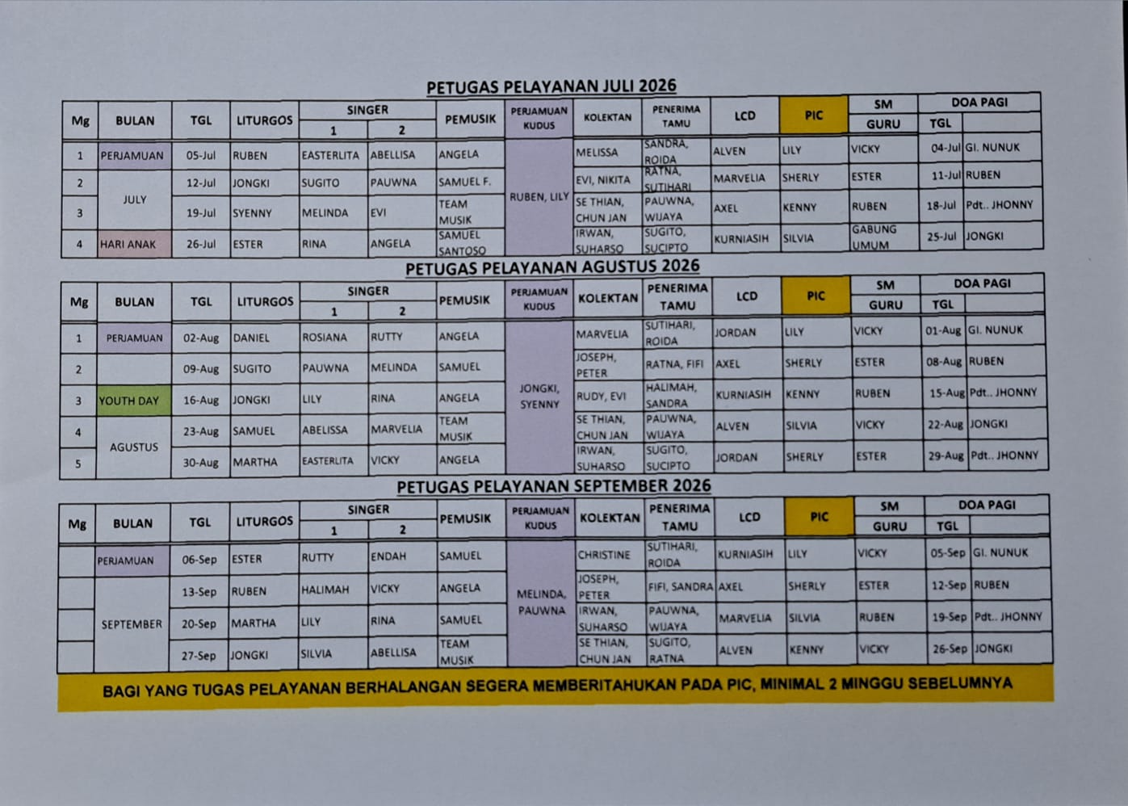

Slide 4


Servants

Slide 5
Registrasi
Fitur
Download
Penutup

Slide 6

gskkelapagading.vercel.app

Slide 7






Slide 8
Bagi HP Android, download file GSK.apk di grup whatsapp jemaat

Slide 9
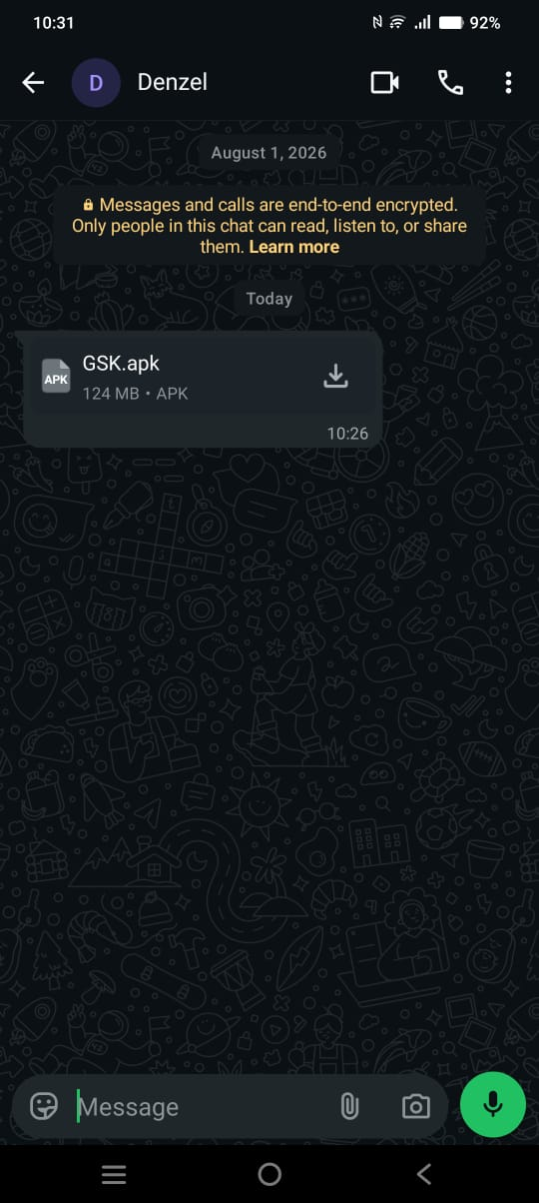

Slide 10
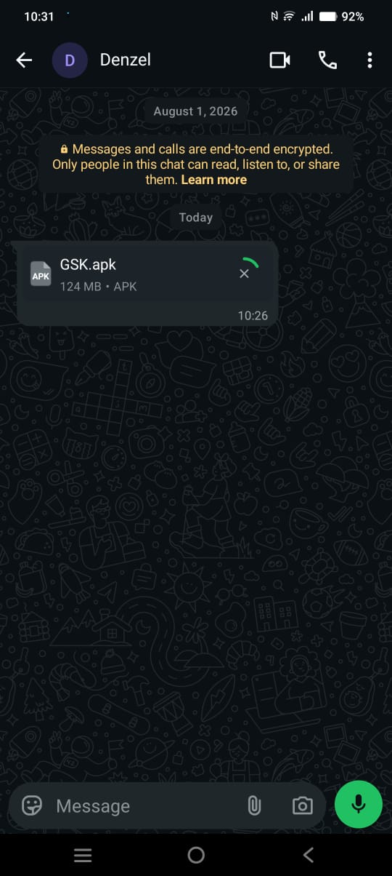

Slide 11
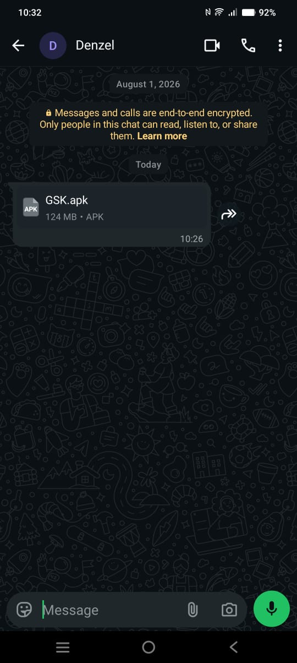

Slide 12
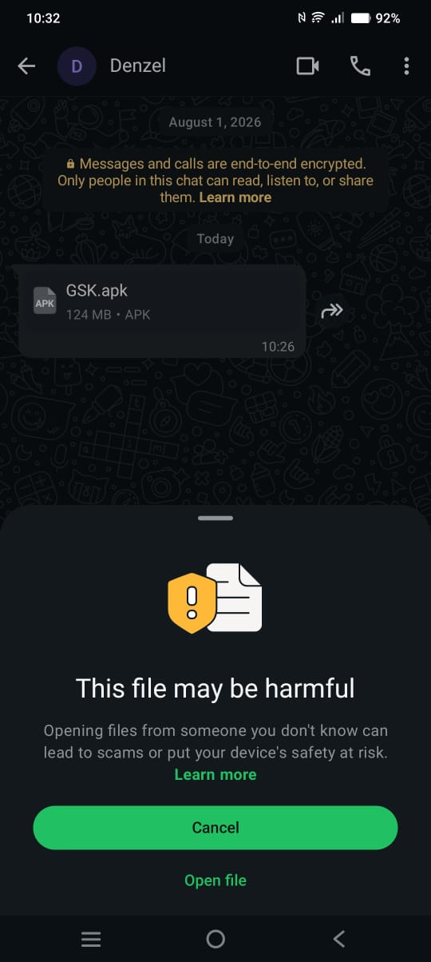

Slide 13
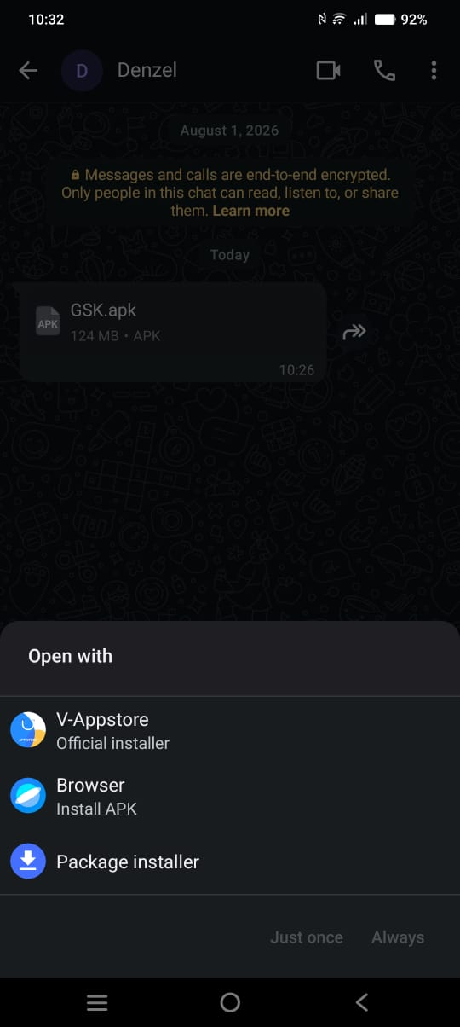

Slide 14
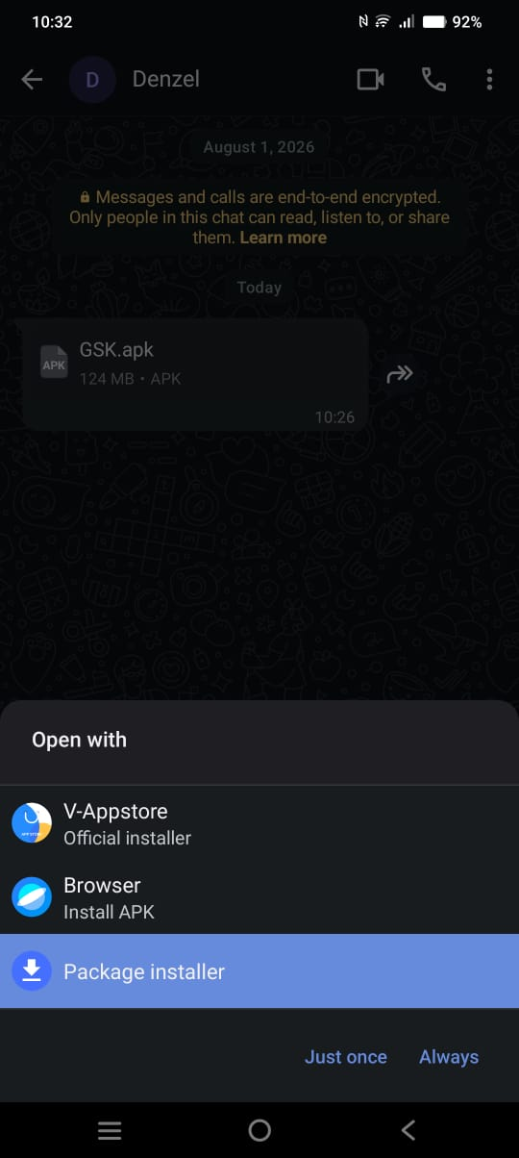

Slide 15
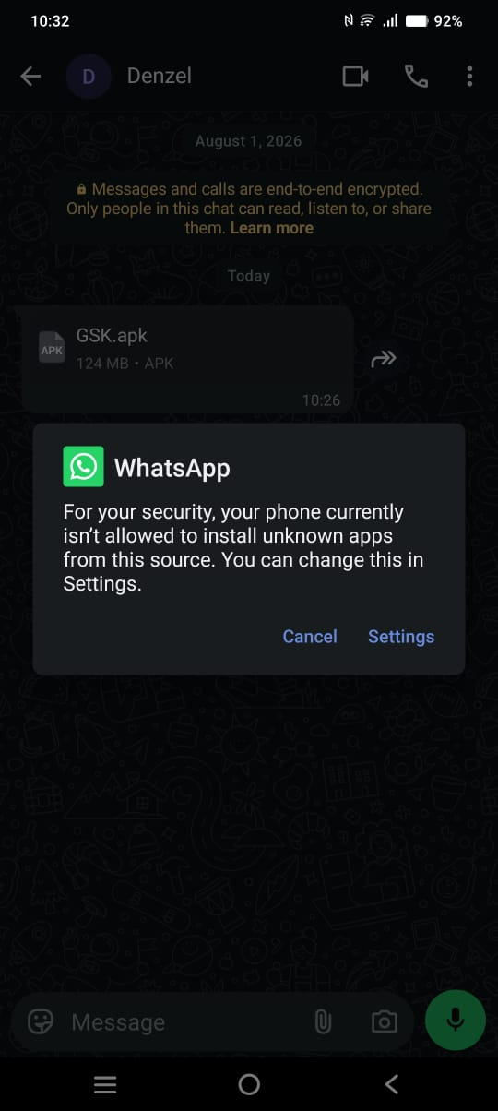

Slide 16
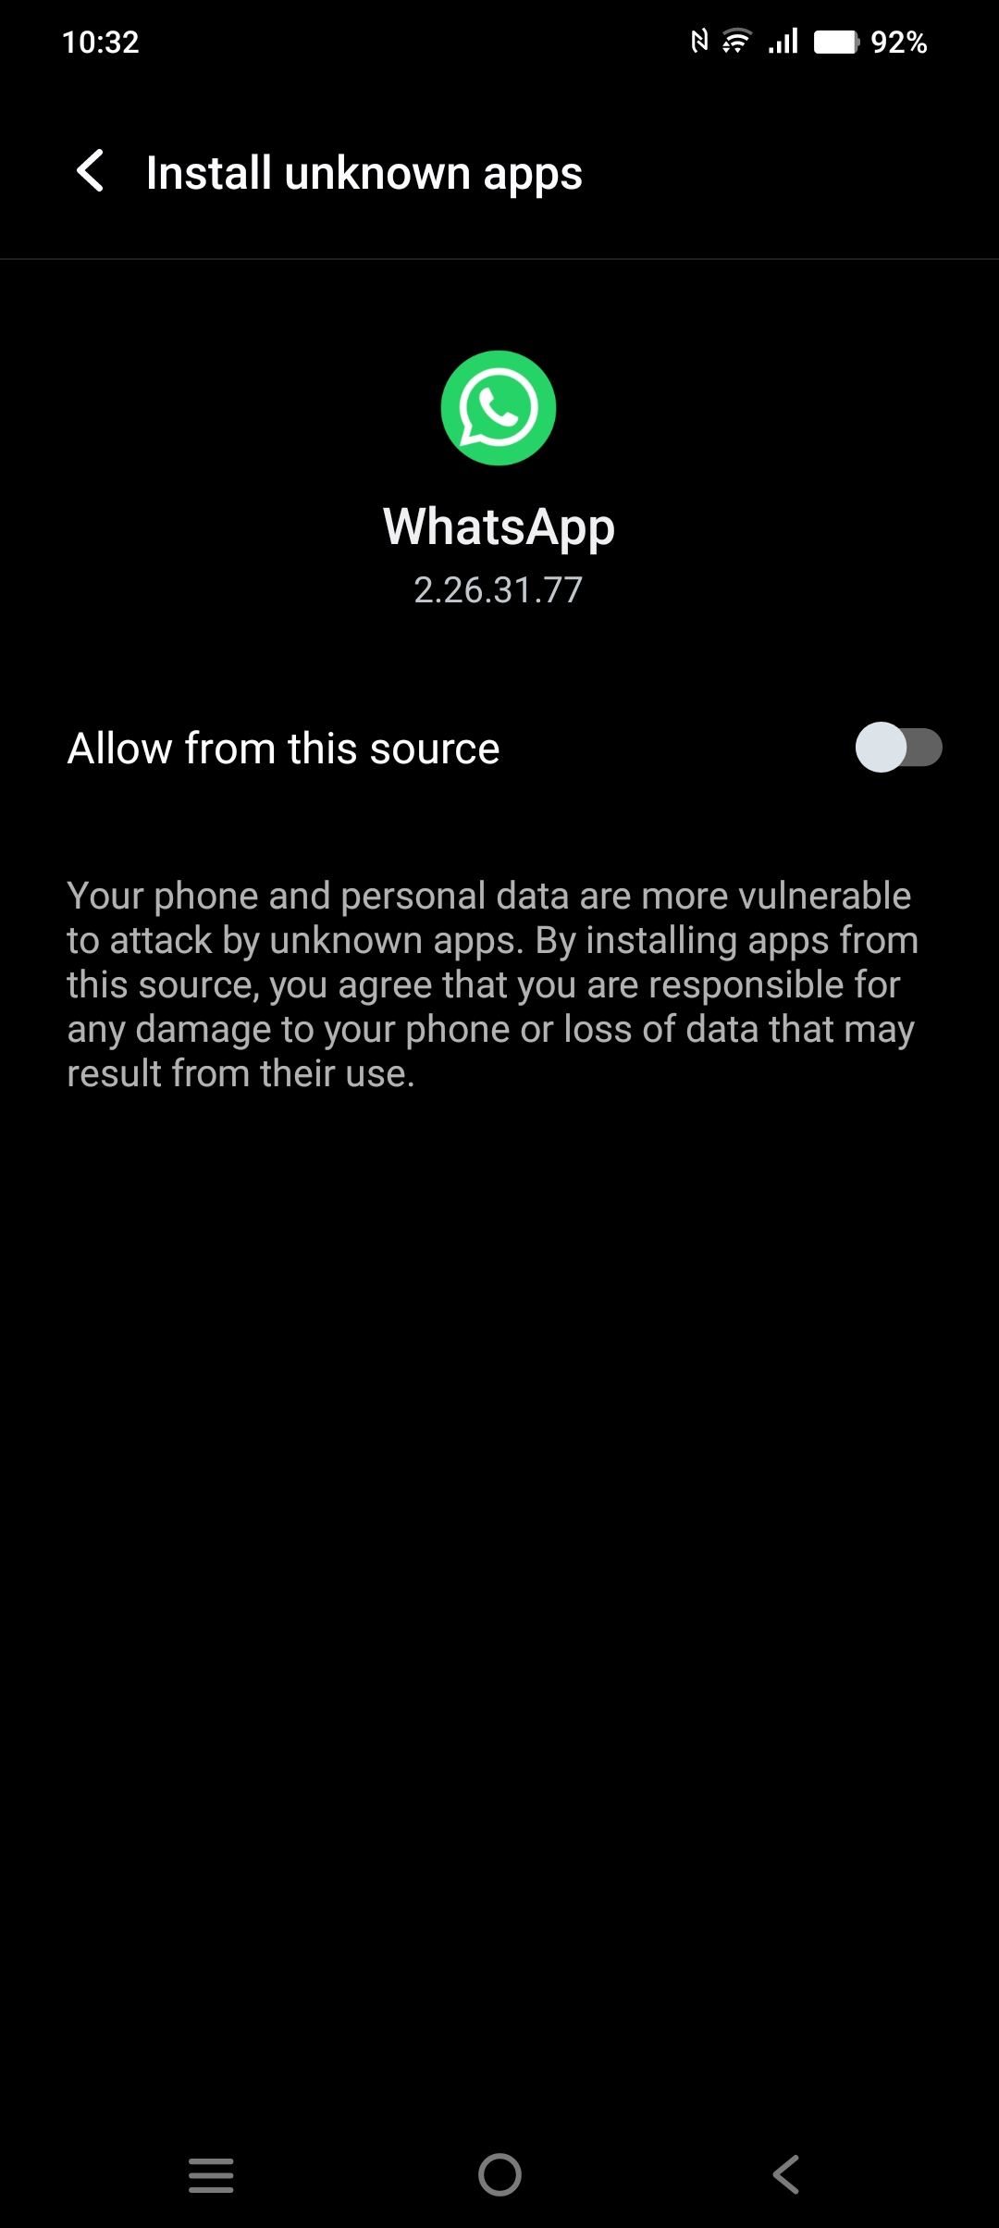

Slide 17
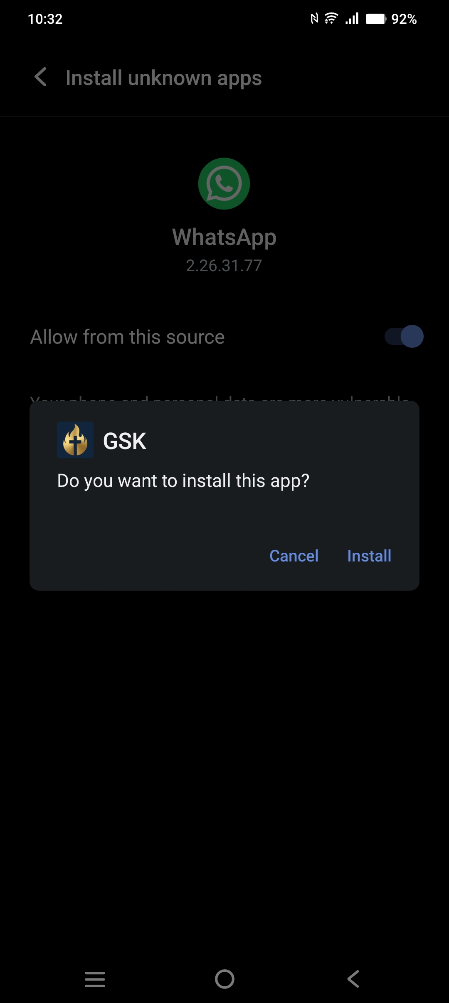

Slide 18
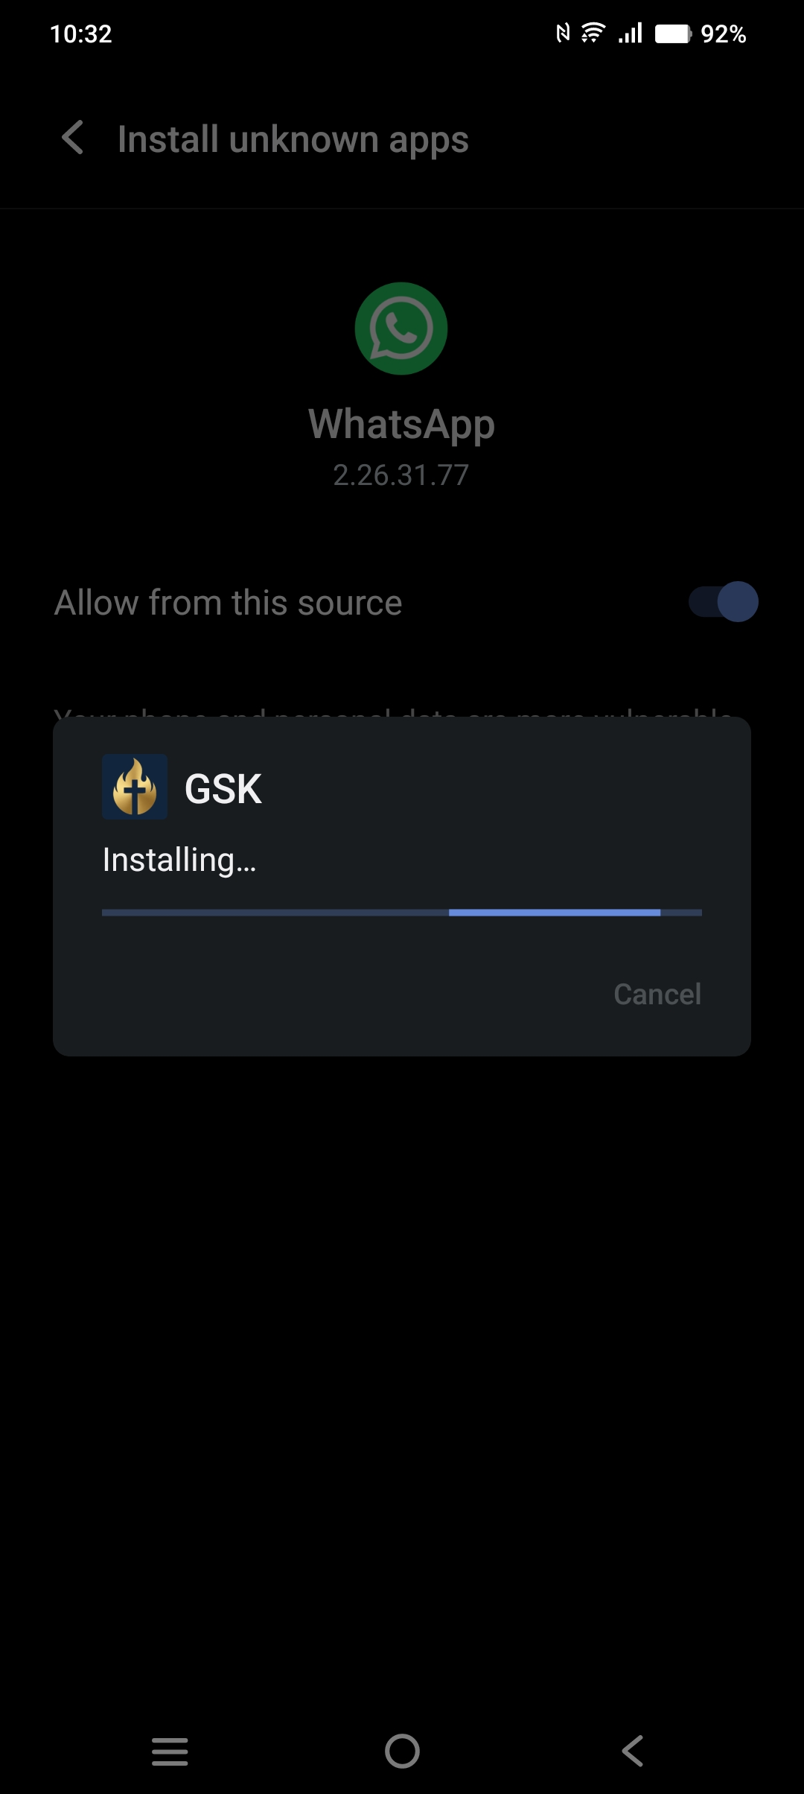

Slide 19
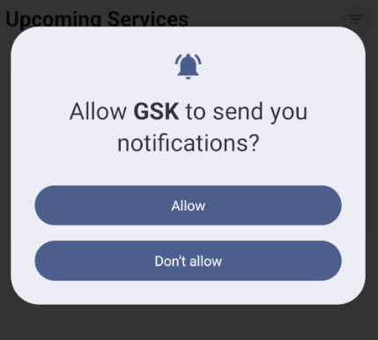
Click “Allow Notifications”

Slide 20
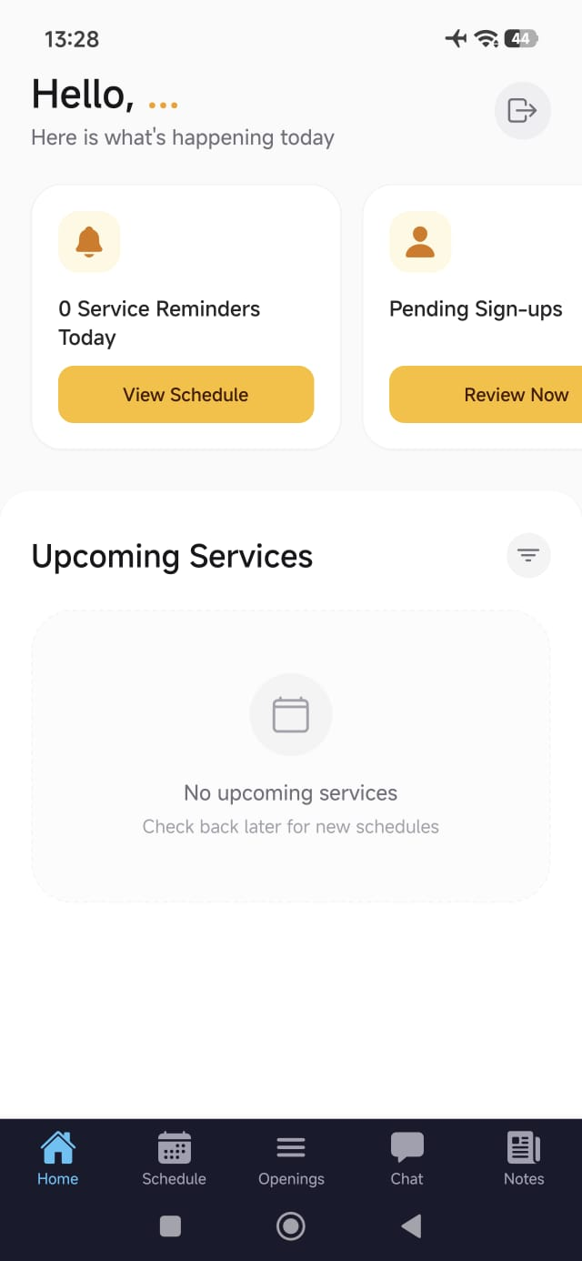

Slide 21
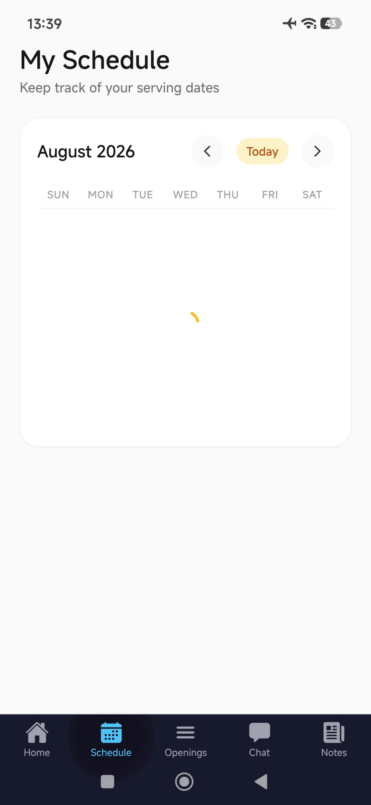

Slide 22

https://forms.gle/qzt8Hf5jGSzTQZxZ8

